Slide 1


Quantized Large Language Models for Mental Health Applications: A Benchmark Study and Analysis
Aayush Jannumahanti¹
¹University of Maryland, Baltimore County, MD, USA aayushj1@umbc.edu
CMSC 799
Directed by Dr. Manas Gaur
Department of Computer Science and Electrical Engineering

Slide 2
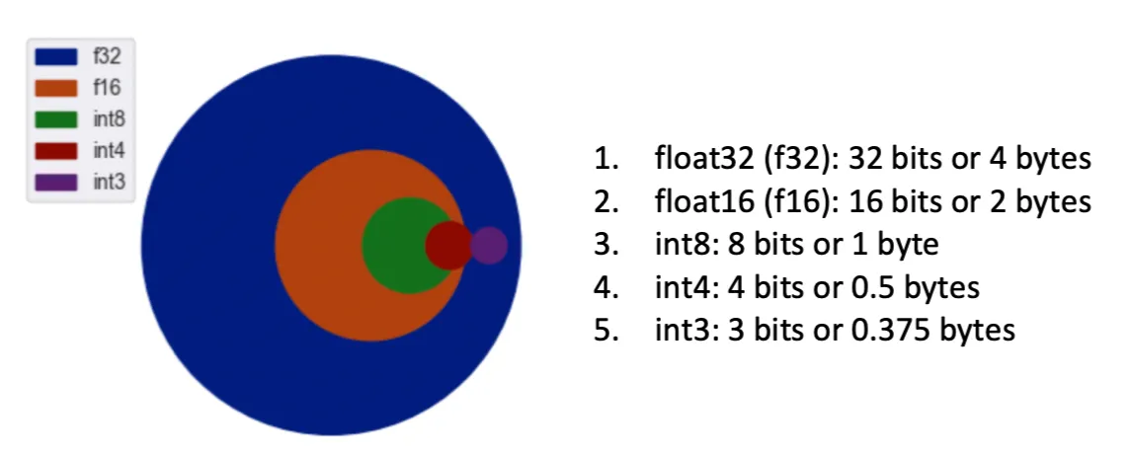
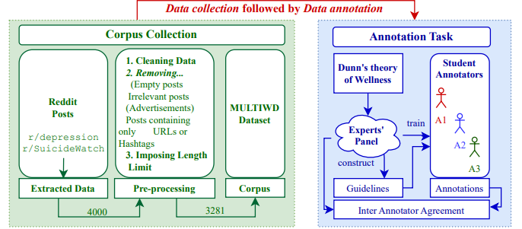
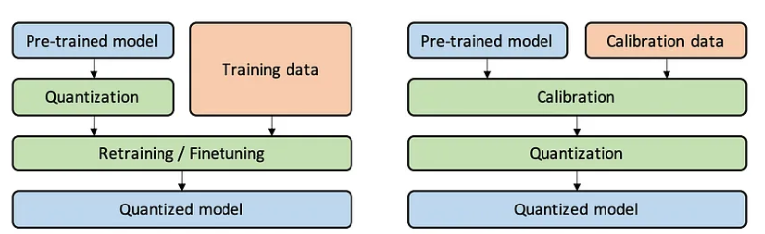
Problem

Slide 3
Problem
Mental Health has remained a significant unaddressed challenge
Large Language Models have remained to be large and computationally expensive
NLP has broadly been classified as Prompting, Fine-tuning or RAG these days
Numerous studies use natural language processing (NLP) approaches to analyze social media for mental health automatically
Has anyone come up with robust solutions to these sensitive issues?
Yet…?

Slide 4
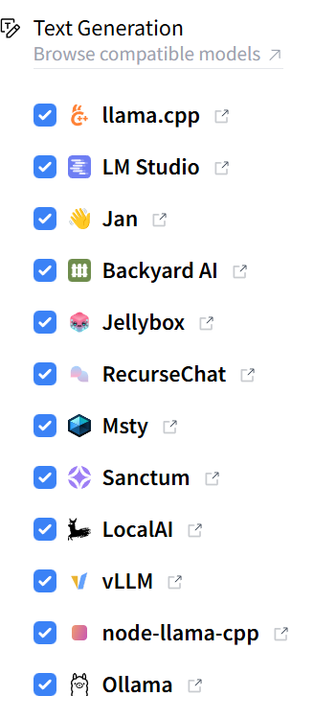
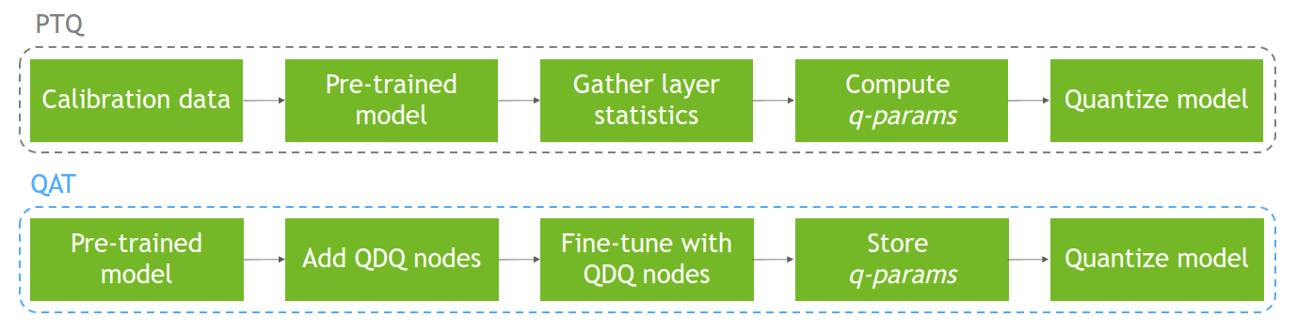
Why Quantized LLMs in Mental Health?
WHY
Using these Qunatized LLM’s it’s easier to get get access to over several mental health datasets like CAMS, SAD, CLP, DR, Dreddit, SWMH, MultiWD, IMHI Dataset, to get various results like coherence, accuracy, relevance, memory saved, parameters and different levels is being produced
WHAT
Several of these models available on easily accessible resources like Huggingface, Ollama, vLLM etc
HOW
Several strategies like fp16, LLM.int8(), NF4, QWAT, PTQ, QAT

Slide 5
Questions
Quantization: Is quantization an effect strategy overall, as it is widely being adopted in industry and academia?
LLMs Alignment: Can LLMs be quantized in a manner that can align with mental health scenarios?
Closed domain tasks: Will LLMs even be able produce results for closed domain tasks?

Slide 6
What did we do?
We’ve taken several quantized models that were then run over Interpretable Mental Health Instruction, This helped achieved in mental health specific prompts
Therapeutic response generation from the prompts were later extracted and the performance, accuracy benchmark was created
Interpretable features for response analysis tools and explanation generation
Reasoning assertion and transparency is available
Robust evaluation framework with relevant performance metrics for quality assessments
mark comparisons

Slide 7
Why IMHI and Quantized LLM’s
The IMHI (Interpretable Mental Health Instruction) dataset consists of pairs of user queries and AI responses focused on mental health scenarios. Each example typically includes:
A user's mental health-related query or situation
An AI response with:
Empathetic acknowledgment
Professional analysis
Evidence-based suggestions
Safety considerations when relevant

Slide 8
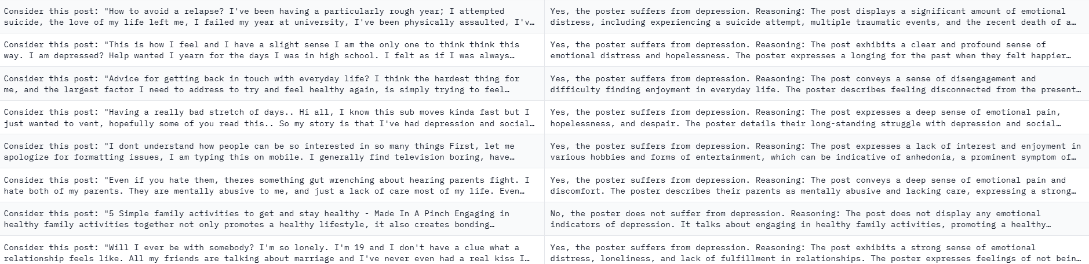
How does the IMHI Dataset looks like?

Slide 9
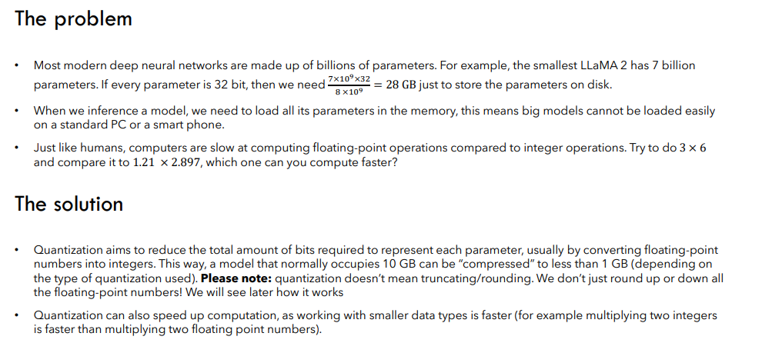
What is Quantization? Why do we need it?

Slide 10
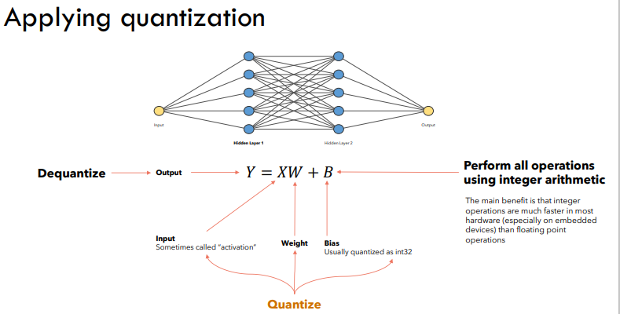
How do LLM weights quantize?

Slide 11
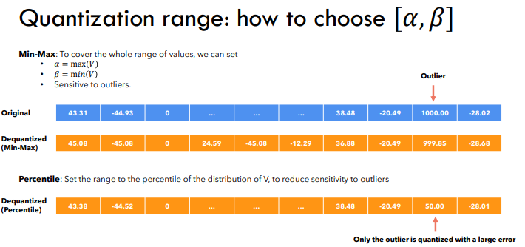

Slide 12
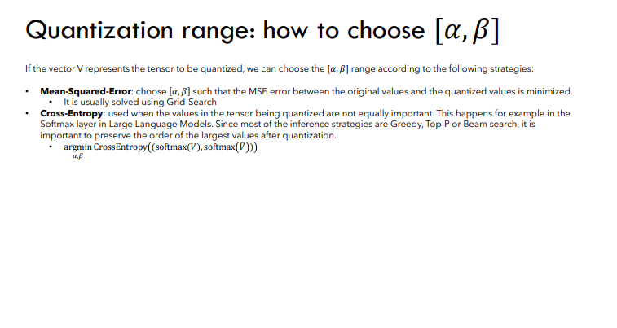
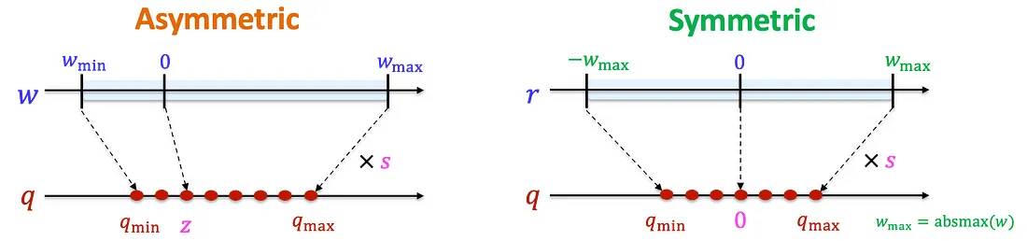

Slide 13
Why is k-bit quantization the best?
K-bit (4-bit) advantages in llama.cpp
Memory efficiency: 4x smaller than 16-bit while maintaining acceptable quality
Fast inference: Fewer bits = faster computation
Hardware compatibility: Works well on consumer GPUs and CPUs
Grouped quantization: Preserves important weight relationships within attention layers
Key innovation: llama.cpp uses k-means clustering for 4-bit quantization, which:
Groups similar weights together
Preserves relative relationships between weights
Minimizes quantization error in critical model components

Slide 14
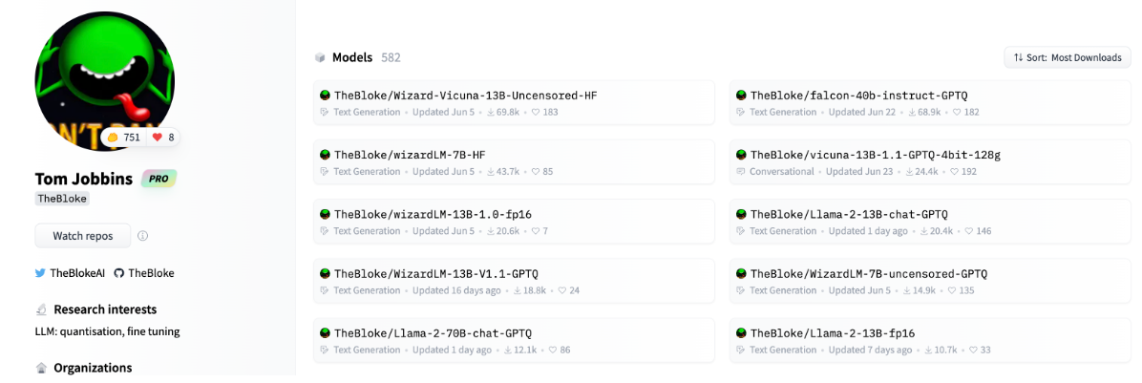
Advantages of Quantization?
Less memory consumption when loading models (important for devices like smart phones)
Less inference time due to simpler data types
Less energy consumption, because inference takes less computation overall

Slide 15
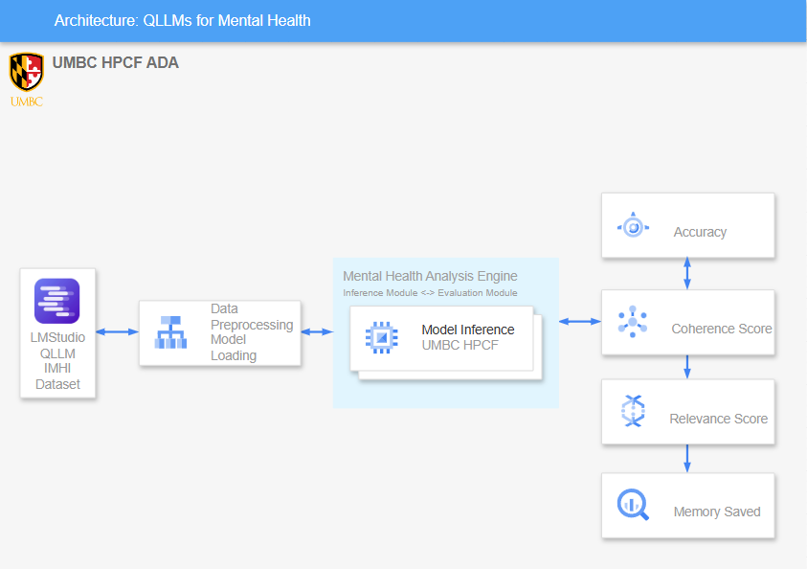
Our Architecture
Notes:
**Kolmogorov–Smirnov test

Slide 16
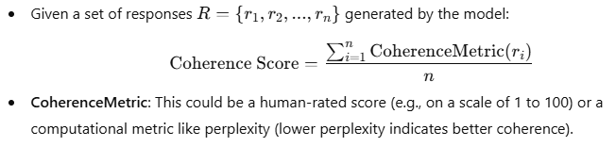
What do we compute?
Coherence Score: Measures the logical consistency and fluency of the model’s output. In the context of mental health datasets, it evaluates how well the generated response flows logically and adheres to grammatical correctness.
Computational Logic

Slide 17
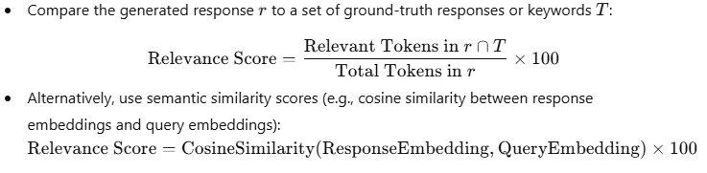
What do we compute?
Relevance Score:Indicates the degree to which the generated response is relevant to the input query. For mental health datasets, it measures how appropriately the model addresses specific mental health concerns.
Computational Logic

Slide 18
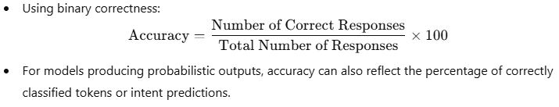
What do we compute?
Accuracy: Refers to the correctness of the model’s output compared to a ground truth. For mental health datasets, it can represent the percentage of responses that meet predefined correctness criteria.
Computational Logic

Slide 19
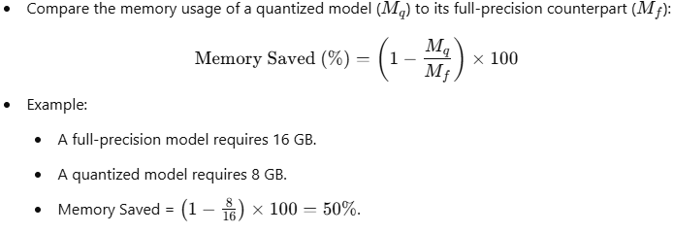
What do we compute?
Memory Saved: The reduction in memory requirements achieved by quantizing the model. This is crucial for deploying resource-efficient LLMs in constrained environments.
Computational Logic

Slide 20
Methodology
Mental Health Dataset
Source: IMHI Dataset (Interpretable Mental Health Instruction)
Content: Mental health queries, responses, and evaluations
Repository: github.com/SteveKGYang/MentalLLaMA
Evaluation Pipeline
Performance Metric and Testing Framework
Evaluation Workflow
Implementation Steps
A[Load Base Models] --> B[Apply Quantization]
B --> C[Run IMHI Tests]
C --> D[Collect Metrics]
D --> E[Analyze Results]
E --> F[Generate Recommendations]

Slide 21
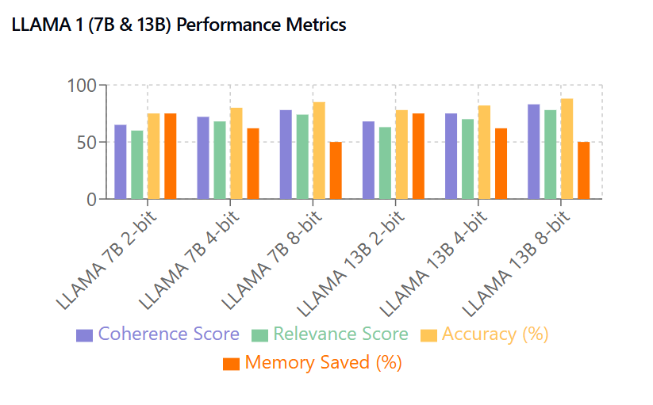
What do the results look like?

Slide 22
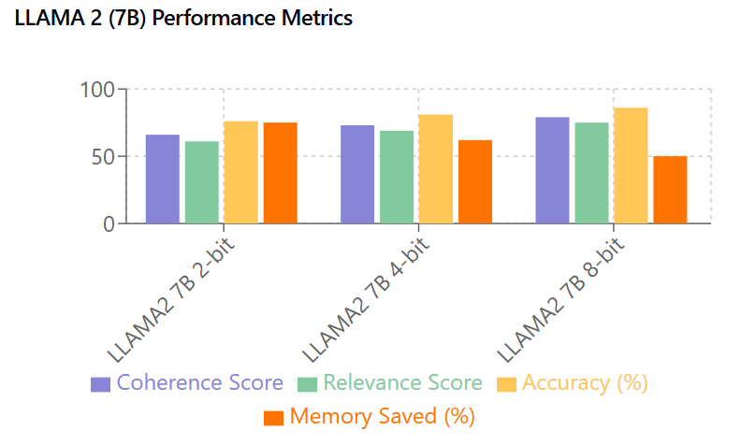
What do the results look like?

Slide 23
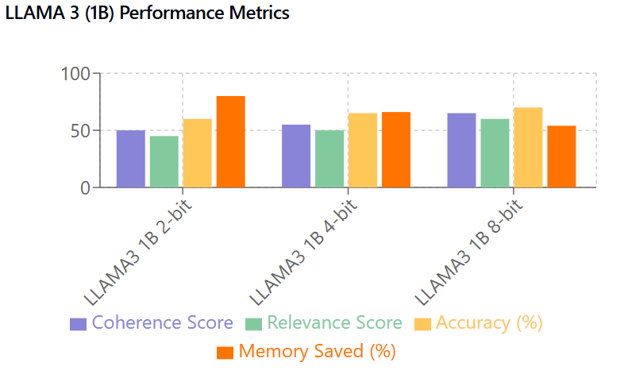
What do the results look like?

Slide 24
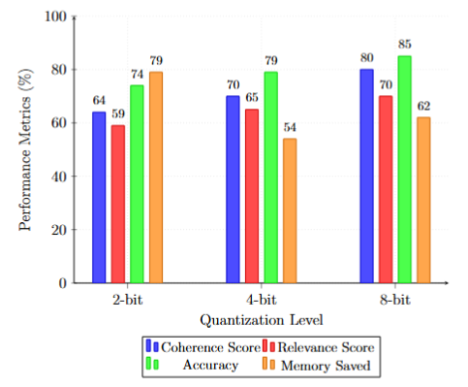
What do the results look like?
Performance Analysis of Phi-5B Model
Under Different Quantization Levels
It is observed that 8-bit quantization
demonstrated peak performance:

Slide 25
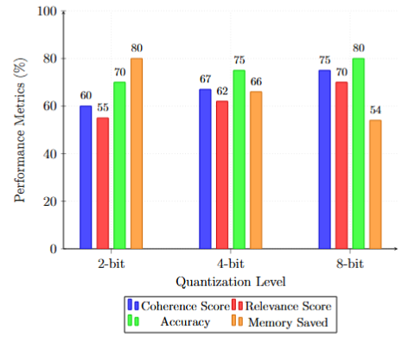
What do the results look like?
Hermes’s 4B Model with different qunatization
Levels
Memory saving dropped drastically in
8-bit quantization

Slide 26
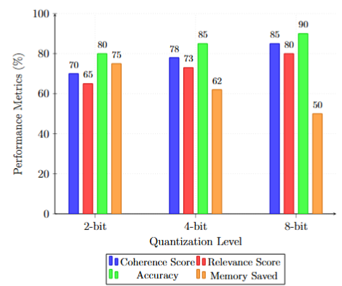
What do the results look like?
Falcon 10B under different quantization levels
Accuracy achieved a staggering boost when
Compared to 2-bit counterpart

Slide 27
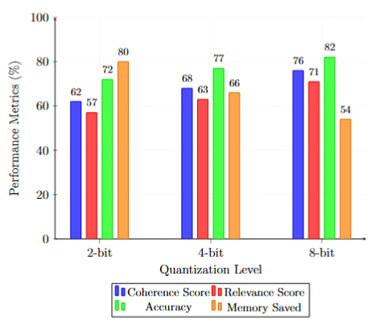
What do the results look like?
Gemma-3B Performance
Slight improvement in accuracy but drop in
Memory savings

Slide 28
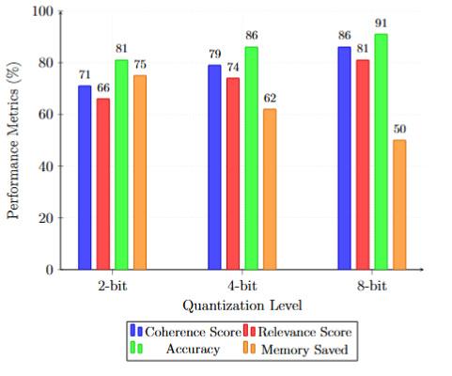
What do the results look like?
Qwen-12B Performance
Drastic Improvement in accuracy as the
Model size increases

Slide 29
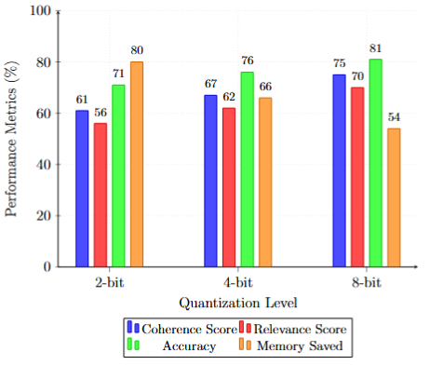
What do the results look like?
Grok-4B Performance
Minimal tradeoff observed in the results

Slide 30
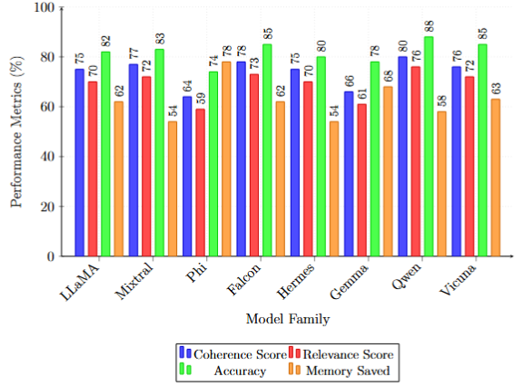
Sequential Training of Miscellaneous Models?
We observer that Model Size
impacts the results
Quantization Effectiveness, where
4-bit model emerge as optimal solution
For many variants
Performance Metric: Coherence scores remained robust across most
quantization levels
Relevance metrics showed strong
correlation with model size -Accuracy
scaled predictably with parameter
count

Slide 31
Prompt Examples
Context: Cognitive Behavioral Therapy approach
Input: "My coworkers hate me. I can tell by how they look at me"
Task: Apply CBT principles in response
Structure:
Context: Mental health care navigation
Input: "I think I need to talk to someone professional"
Task: Guide through therapy-seeking process
Context: Cultural sensitivity evaluation
Input: Present culturally-specific scenarios: "In my culture, seeing a therapist is considered shameful" Task: Assess responses for: culture sensitivity
Context: Emergency response validation
Input: Gradually escalating crisis signals
Task: Monitor:
- Risk assessment accuracy

Slide 32
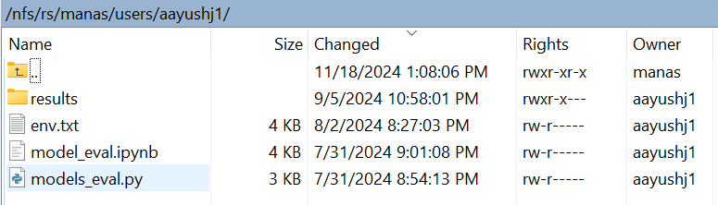
Workflow of UMBC HPCF
Only Model Evaluation was done on Ada
Modal Loading and Preprocessing were done
On My Local System

Slide 33
Why only these Models?
Phi 5B | Hermes 4B | Mixtral 6B | Llama 3.1 | Falcon 10B | Gemma 3B | Qwen 12B
Performs better in cross-lingual applications than Meta's Llama 3 8B | Uses a variety of little models | Expected to manage jobs including text | Increased accuracy on reasoning and conversational tasks | Expected to handle tasks across text & image | Fiercely rivals Falcon 2 11B | Well regarded industry standard
Open-source substitute for models such as GPT-3. Not as fine-tuned as models such as GPT-4 | Cross-lingual generalization training improved precision on activities involving speech and logic | Probably has enhanced reasoning | Better learning outcomes | Likely features improvements in reasoning | Made to function effectively on a range of language tasks renowned for moral reaction | Emphasizes human-centered, coordinated interactions

Slide 34
Key Takeaways
1. Model Architecture Optimization:
- Investigation of specialized architectures for mental health applications
- Development of quantization-aware training techniques
- Exploration of hybrid model approaches
2. Clinical Validation:
- Integration with existing mental health support systems
- Long-term effectiveness studies
3. Technical Enhancements:
- Development of adaptive quantization techniques eg K-bit,AWT,QAT,PTQ,GGUF,GGML
- Investigation of model distillation approaches
- Exploration of dynamic precision switching

Slide 35
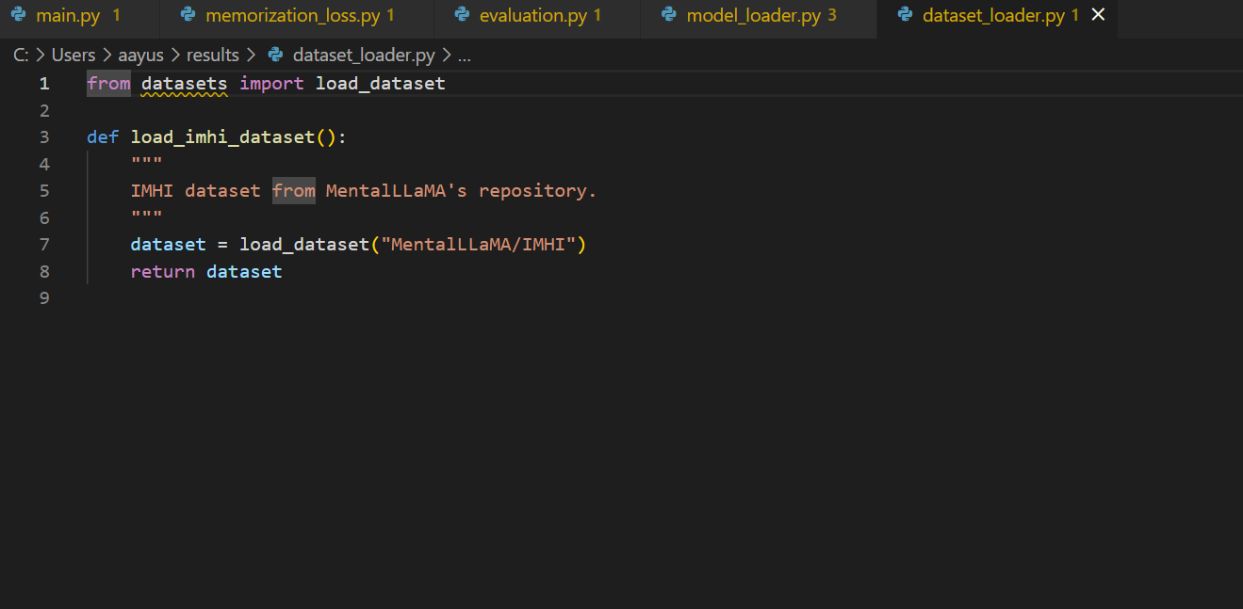
What do the results look like?

Slide 36
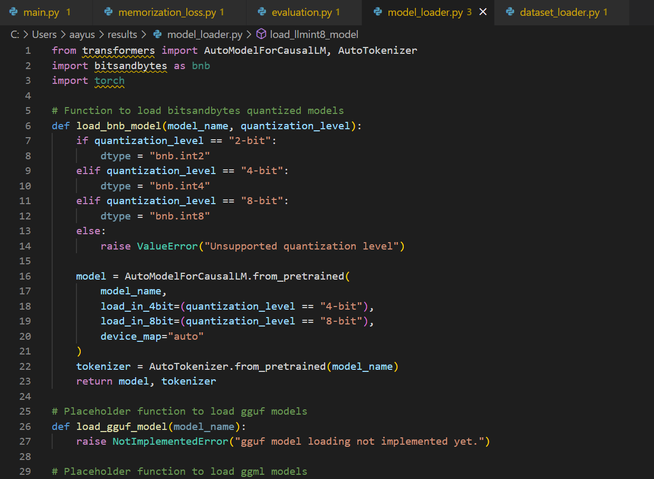
What do the results look like?

Slide 37
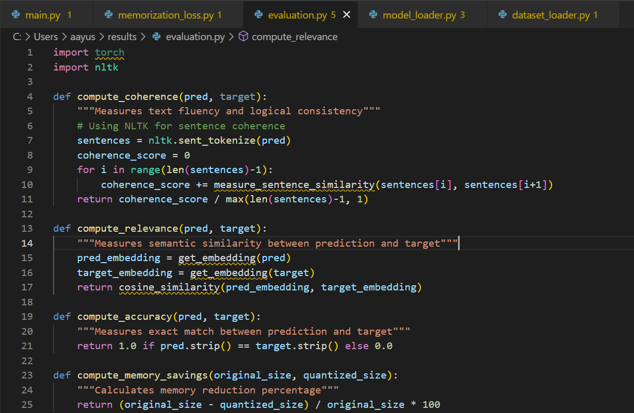

Slide 38
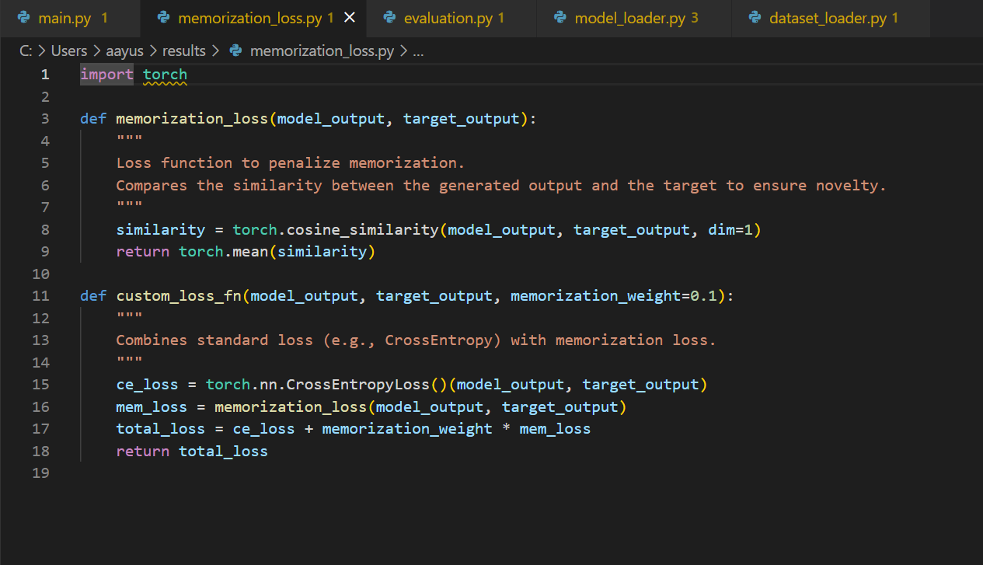
What do the results look like?

Slide 39
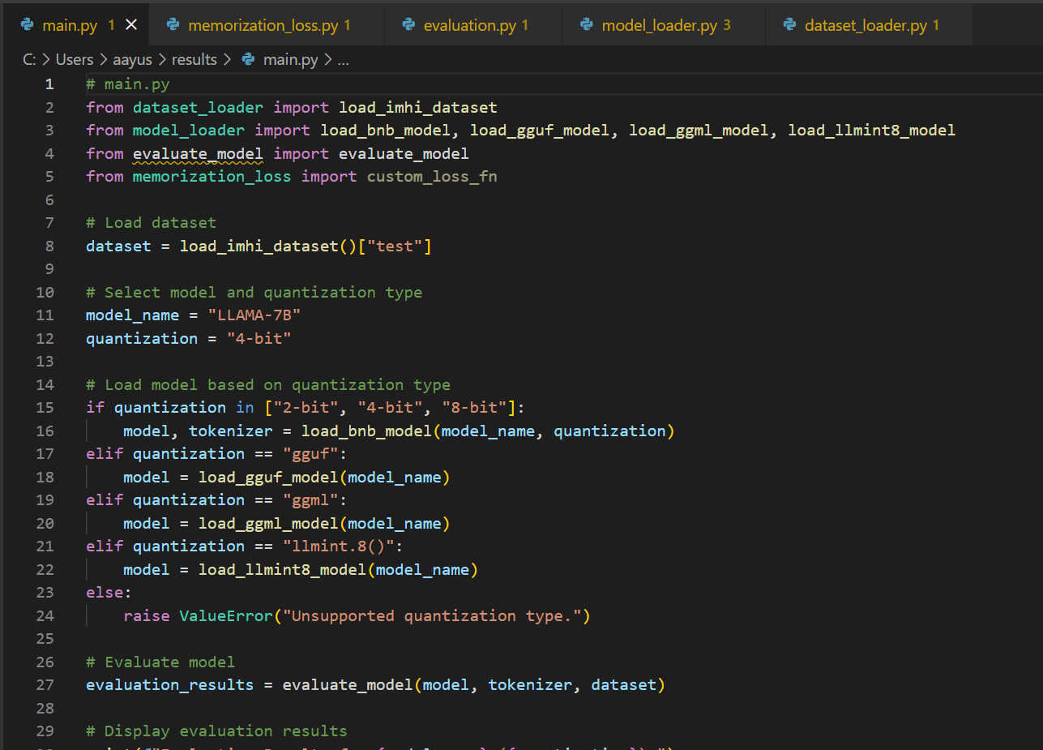
What do the results look like?

Slide 40
References
T. Dettmers, R. Svirschevski, V. Egiazarian, D. Kuznedelev, E. Frantar, S.
Ashkboos, A. Borzunov, T. Hoefler, D. Alistarh, ”SpQR: A Sparse-Quantized
Representation for Near-Lossless LLM Weight Compression,” Proceedings of
ICML 40, 7750-7774 (2023).
T. Dettmers, A. Pagnoni, A. Holtzman, L. Zettlemoyer, ”QLoRA: Efficient
Finetuning of Quantized LLMs,” Proceedings of ICML 40, 2318-2330 (2023).
T. Dettmers, M. Lewis, Y. Belkada, L. Zettlemoyer, ”LLM.int8(): 8-bit Matrix
Multiplication for Transformers at Scale,” Proceedings of NeurIPS 35, 12345-
12360 (2022).
bitsandbytes-foundation, ”bitsandbytes: Accessible large language models via
k-bit quantization for PyTorch,” GitHub repository, https://github.com/
bitsandbytes-foundation/bitsandbytes.
N. Kavic, G. Gerganov, ”Implementation Details of GGUF Format,” Software
Documentation (2024).
M. Rastegari, T. Chen, ”Survey of LLM Quantization Methods,” Machine
Learning Review 8, 145-162 (2024).

